Slide 1
Lecture 7
Autoencoders

Slide 2
Finding Good Representations
original hard
representation
new easier
representation
solution!
A general approach to solving a difficult ML problem (e.g., classification):
But how to find the new representation space?
Option 1: Use multi-layer NN on the target problem and let BP+ discover a good internal representation for the output layer.
Option 2: Force a multi-layer NN to solve an easier pretext problem, forcing it to generate a good internal representation, then use this representation for the target problem.
Autoencoders

Slide 3
Autoencoder
Pretext
Problem
A multi-layer feed-forward neural network that is trained to reproduce its input vector as output.
Autoencoders typically – but not always – use hidden layers that are smaller than the input/output size.
y₁
x₁
Output Layer
Input Vector
H₁
H_{k}
H_{q}
x_{n}
y_{n}
AEs can be used to find new representations and latent variables
A good introduction to autoencoders

Slide 4
Shallow Autoencoder
x₁
y₁
Hidden
Layer
x₂
y₂
x₃
y₃
x₄
y₄
x_{n-1}
y_{n-1}
x_{n}
y_{n}
+1
Bias

Slide 5
Basic Idea
x₁
y₁
Input Vector
H₁
Output Layer
x_{n}
y_{n}
Encoder Stage:
The hidden layer encodes the input into a new, more useful representation.
For example, the new representation could be:
Lower-dimensional (compressed).
More orthogonal (having less correlated features).
More sparsely coded.

Slide 6
x₁
y₁
Input Vector
H₁
Output Layer
x_{n}
y_{n}
Decoder Stage:
The encoded representation in the hidden layer is decoded back to the original.
This requires that the encoded representation must retain all the information necessary to reconstruct the original
The hidden layer neurons define a new feature space for the original data.

Slide 7
If the hidden layer is narrower than the input/output layers, the learning process is forced to:
Compress the original data into fewer dimensions
Squeeze out useless and redundant information
Find a smaller set of features that are more significant and informative.
If the hidden layer activity is forced to be sparse, the learning process is forced to:
Find features that are more dissimilar from each other
Make the features more specific to particular aspects of the input data
Create a representation with more distinct and meaningful dimensions.
Create more distinct representations for sufficiently different data points.

Slide 8
Latent Variables
Latent (hidden) variables or factors are a set of informative but unobservable variables that can explain the behavior of a set of observable variables.
Latent variables can serve many functions:
Acting as Basis Variables: Observables are represented as mixtures (e.g., linear combinations) of the latent variables,
e.g. principal components, eigenvectors, eigenfunctions, etc.
Explaining Complex Behavior: Complex, high-dimensional observable behavior can be explained in terms of structured interactions between a few latent variables, e.g., explaining texts in terms of topic mixtures, or human behavior in terms of personality types.
Explaining Statistical Dependencies: The statistical dependence between observables can be explained by latent variables, e.g.
P(x,y|h) = P(x|h)P(y|h)
Autoencoders can discover useful latent variables

Slide 9
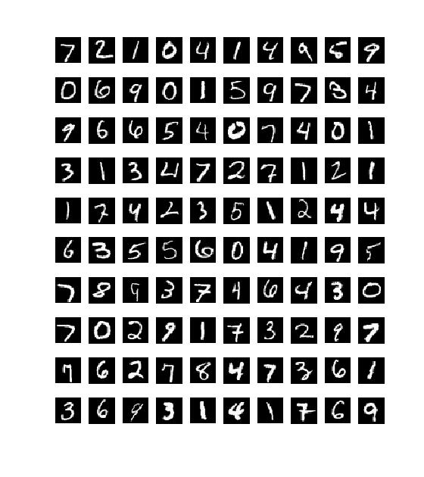
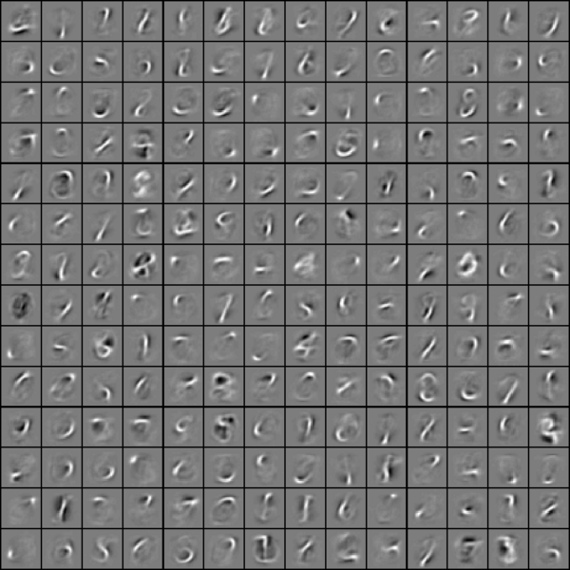
Discovering Features with Autoencoders
Features found by a
Sparse Autoencoder
MNIST Dataset (partial)
http://ufldl.stanford.edu/wiki/index.php/Exercise:Vectorization

Slide 10
Regularization
Weight Penalty: Forces better generalization by keeping the weights smaller.
N = number of layers
Weight Penalty
Sparse Coding: Forces hidden layer features to be more diverse by allowing each hidden neuron to be active only for a small fraction of data points.
Mean activity of hidden neuron j over all N data points
Divergence of activity from desired
Cost function with sparseness constraint
Dropout: Forces hidden layer features to be more diverse by disrupting co-adaptation

Slide 11
Weight Penalty: Forces better generalization by keeping the weights smaller.
D = number of layers
Weight Penalty
This leads to a small change in the calculation of the gradient function:
Typically, the Lagrange multiplier λ is set to a very small value like 0.001

Slide 12
Sparse Coding: Forces hidden layer features to be more diverse by allowing each hidden neuron to have only limited average activity.
Mean activity of hidden neuron j over all N data points
Divergence of activity from desired
Cost function with sparseness constraint
Appendix
To see how this affects the gradient calculation, note that:
Since only the l = j term is affected by w_{jk}

Slide 13
(a)
(1)
Appendix
(b)
(2)
(c)
(3)

Slide 14
(1), (2) and (3) give:
Recall that in basic backpropagation, we had:
Appendix
From the first term of the loss function
Now we have:

Slide 15
Then, as before:
Note that
Appendix
w_{jk} decreases
w_{jk} increases
Typically, γ is set to a value in the range of 1-5, and in the range of 0.01-0.05.

Slide 16
Building Multi-Stage Autoencoders
x₁
y₁
Input
H₁
Output
H₁
H₂
H₁
x_{n}
y_{n}
Stage 1
Stage 2
x₁
y₁
Input
H₁
H₂
H₁
Output
x_{n}
y_{n}
Final Network – possibly with some further end-to-end BP training

Slide 17
Autoencoder-Based Deep Classifier
1. Pre-trained in the autoencoder
x₁
C₁
Input
H₁
H₂
Classifier
C_{m}
x_{n}
2. Trained as a simple classifier
3. Fine-tuned as a deep network with back-propagation
The classifier could be a layer of neurons (LMS), a multi-layer network, a softmax classifier, etc.

Slide 18
Denoising Autoencoder
x₁
y₁
Hidden
Layer
x₂
y₂
x₃
y₃
x₄
y₄
x_{n-1}
y_{n-1}
x_{n}
y_{n}
+1
Bias
No Noise
Noise

Slide 19
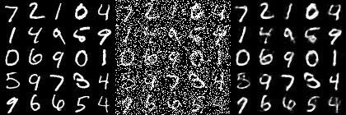
After Learning:
- Can be used to clean up new noisy inputs.
Clean
Input
Noisy
Input
AE
Output
From:
https://towardsdatascience.com/denoising-autoencoders-explained-dbb82467fc2
The hidden layer neurons can be used as robust features for classification, etc.

Slide 20
Other Autoencoder Models
Convolutional autoencoders use convolutional networks to encode images and deconvolution to decode them.
Variational autoencoders learn a stochastic latent space through the encoder and sample from it to generate reconstructions.

